Slide 1
Phlebotomy Problems

Slide 2
Phlebotomy Problems
Failure to obtain blood.
Reasons may help with second attempt
Remain calm as you asses the problem.
Common causes:
Bevel is against the wall of the vein
The needle pierced all the way through the vein. Insertion of the needle at an angle greater than 15 degrees is a likely cause.
The needle is only partially inserted into the vein, possibly because the needle is inserted at less than a 15 degree angle.
The needle has missed the vein entirely. (Do not probe excessively if the vein is missed because this bruises the arm and could hemolyze the red blood cells.

Slide 3
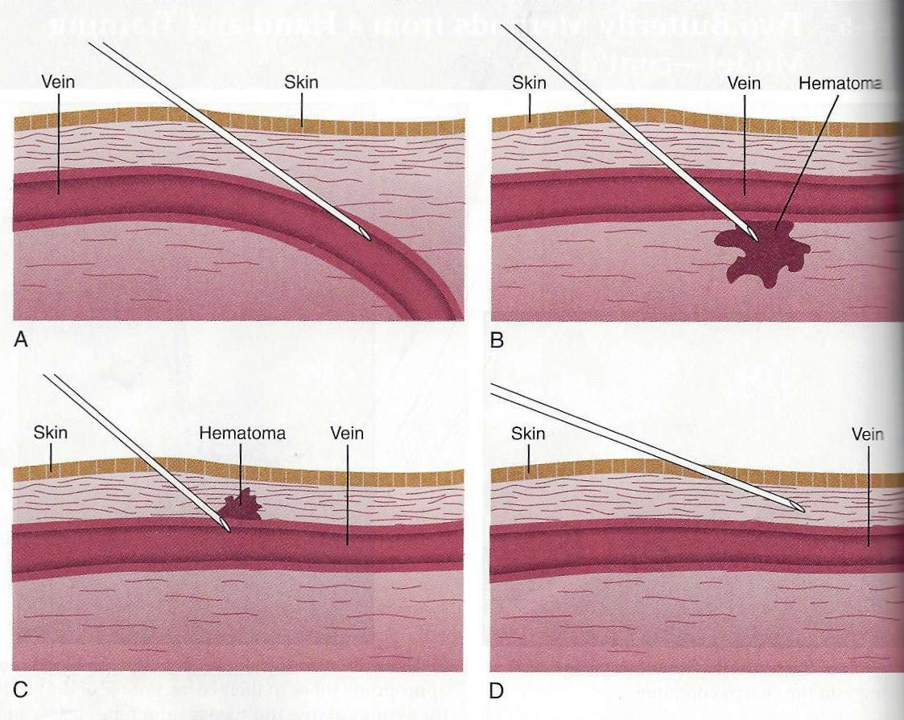
Phlebotomy Problems
B. Needle bevel has gone through the vein.
A. The needle is on the wall of the vein.
D. Needle bevel has completely missed the vein.
C. Needle bevel is only partially inserted into the vein, causing blood to leak into the tissues.

Slide 4
Phlebotomy Problems
Failure to obtain blood
A defective tube has been used. Always inspect prior to use and do not evacuate the tube prior to the phlebotomy.
Important rule! A patient should never be stuck more than two times by the same phlebotomist.
FYI: There is now an instrument that transiluminates the surface of the skin with infrared light to assist in locating difficult to find veins.

Slide 5
Phlebotomy Problems
www.youtubwww.youtube.com/watch?v=IRynM8i-2rce.com/watch?v=IRynM8i-2rc

Slide 6
Phlebotomy Problems
Syncope: fainting
Symptoms
Pallor
Sweating
Hyperventilation
If patient expresses concerns about fainting
Place him or her in a reclining position prior to beginning the phlebotomy.
If patient feels faints during the procedure:
Remove tourniquet
Remove needle from the arm and engage safety device.
Have patient lower their head and breathe deeply.

Slide 7
Phlebotomy Problems
Syncope continued
Feels faint during procedure
Place a cold or wet towel on the forehead and back of the neck.
Do not attempt to put anything in the patient’s mouth.
If possible, place the patient in a reclining position and stay with them at least 15 minutes after they have recovered.
Patient should not drive for at least 30 minutes after recovering.
A glass of juice may be helpful.
File an incident report listing the facts and follow-up to the incident.

Slide 8
Phlebotomy Problems
Hemolysis: Breaking open of RBCs and release of hemoglobin. Hemoglobin turns serum or plasma pink to red.
Causes for hemolysis:
Using needle gauges that are too small
Collapsing the vein by putting too much pressure on it, either by using the Vacutainer method on a small vein or by pulling back the plunger too quickly with the syringe method.
Vigorously shaking the filled tubes.

Slide 9
Phlebotomy Problems
Hemolysis
Hemolyzed blood releases chemicals into the plasma and serum that adversely affect the test results for the following analytes.
Potassium
Magnesium
Iron
Lactate dehydrogenase
Phosphorus
Ammonia
Total protein.

Slide 10
Phlebotomy Problems
Excessive Bleeding
Patient usually stops bleeding in 2-6 minutes.
Some medications may prolong the bleeding time
Blood thinners (Ex Heparin, Warfarin)
Arthritis medication
Aspirins
Coagulation abnormalities (Petechiae present)
Physician must be notified if bleeding does not stop.

Slide 11
Phlebotomy Problems
Neurological Problems
Seizure: If this occurs during a procedure; immediately remove tourniquet, then needle from arm (engage the safety device); call for help and do not attempt to give patient anything by mouth.
Nerve damage: Patient will experience a tingling sensation radiating down the affected nerve.
Immediately remove the tourniquet and needle and apply pressure to the site.
Notify an authorized person and file an incident report.

Slide 12
Phlebotomy Problems
Obesity
The veins on obese patients may be difficult to see and palpate, making them a challenge to find and penetrate.
Caution must be taken not to probe the area excessively if a vein is missed.
Mastectomy
Do not perform a venipuncture on the arm adjacent to a mastectomy site.
Mastectomy patients may have no lymph flow to that arm because the axillary lymph nodes on the mastectomy side may have been removed. This condition carries a potential risk for infection.
Alterations in body fluids and blood analytes are at risk.
The tourniquet may also injure the patients arm.

Slide 13
Phlebotomy Problems
Intravenous therapy
Drawing blood from a patient’s arm in which there is an intravenous (IV) fluid running is not recommended because the fluid could dilute the results of the tests.
A glucose drip could falsely increase glucose values.
If an arm with an IV tube must be used, always draw on the arm below the IV insertion area.
Edema: (Abnormal accumulation of fluid in interstitial spaces)
Areas affected by edema should not be used for venipunctures because the fluid may contaminate and dilute the test results.

Slide 14
Phlebotomy Problems
Other Areas to Avoid.
Veins that are obstructed in some way – such as those that are sclerosed with plaque, scarred, or occluded- should not be used.
Sites that are burned or occluded should not be used. Sites that are burned are susceptible to infection and should be avoided.
Specimen Re-collection
Sometimes problems with a sample cannot be determined until the specimen is analyzed in the laboratory…..rejected specimen.
Rejected specimens must be re-collected.

Slide 15
Phlebotomy Problems
Rejected Specimens: Reasons
Unlabeled or mislabeled specimen
Insufficient quantity
Defective tube
Incorrect tube used for the test ordered
Hemolysis
Clotted blood in an anticoagulated specimen
Improper handling.
Hemolysis is the major cause of specimen rejection because it cannot be detected until the blood cells separate from the plasma or serum.

Slide 16
Phlebotomy Problems
Chain of Custody
Blood samples may be collected as evidence in legal proceedings.
May be drawn for drug and alcohol testing, DNA analysis or parentage testing.
Samples must be handled according to special procedures to prevent tampering, misidentification or interference with the test results.
Chain of Custody is a legal term that refers to the ability to guarantee the identity and integrity of the specimen from collection to reporting of test results.
Process used to maintain and document the chronologic history of a specimen. (Documents should include the name or initials of the individual collecting the specimen, each person or entity subsequently having custody of it , the date specimen was collected or transferred, the employer or agency the specimen number, the patient’s or employee’s name and a brief description of the specimen.

Slide 17
Phlebotomy Problems
Chain of Custody
Collection kits are available that contain everything needed for the venipuncture, including the tube, the needle, the chain of custody forms and seals, the antiseptic and even the tourniquet.
Familiarize yourself with the kit before using. Involvement with the collection of these types of specimens may also require testimony in a court of law as to your role in the collection and tracking of the specimen.
Patient Education
Mas who work as phlebotomists must maintain professional attitude, yet remain sympathetic to the patient’s fears and anxiety about the procedure.

Slide 18
Phlebotomy Problems
Patient Education:
Establish an environment that encourages the person to relax and minimize the patient’s discomfort and pain during the procedure.
Always remember to identify your patient and explain what you are going to do.
Answer any questions the patient may have and perform the procedure skillfully before anxiety has time to set in.
Provide as much explanation as needed to ease the patient’s anxiety. Sometimes the patient can help by identifying the site of the last successful blood draw.
Make every effort to perform the procedure quickly, efficiently, and effectively.

Slide 19
Phlebotomy Problems
Legal and Ethical Issues:
Venipuncture and microcapillary blood collection are invasive procedures in which a sterile needle or lancet is inserted through the skin. Because the skin is penetrated, drawing blood becomes a surgical procedure and is subject to the laws and regulations of surgery.
When venipuncture is performed, the rules and regulations must be enforced with no deviations.
Be sure to follow the procedures as written and to become familiar with the regulations and standards established by local and state agencies, as well as the CLSI and OSHA.
Deviations leave the Medical Assistant open to accusations of malpractice.
Document any situations that arise in which observation of the standard of care come into question.

Slide 20
The End

