Slide 1
Phlebotomy

Slide 2
Phlebotomy
Involves highly developed procedures and equipment to:
Ensure patient’s comfort
Safety
Standards for phlebotomy developed by different organizations
Training standards for Medical Assistants
Certification available
Complete course work
Train at an accredited institution
Pass a national examination.
Continuing education often required to maintain certification.
California and Louisiana first states to create state certification.

Slide 3
Phlebotomy
Important: Medical Assistants become familiar with the guidelines of their own states.
Not all states require certification to perform phlebotomy.

Slide 4
Phlebotomy
Venipuncture: blood taken directly from a surface vein.
Vein is punctured with a needle
Blood is collected either in a syringe or in a stoppered tube.
Procedure is safe when perform by a professional but must be performed with care.
Practice is needed to become skilled and confident in the technique of venipuncture.

Slide 5
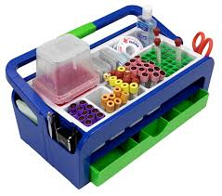
Phlebotomy
Patient preparation:
Seat patient in venipuncture chair
History of syncope; have the patient lie down on examination table.
Equipment used:
Phlebotomists carry the equipment in a portable tray.

Slide 6
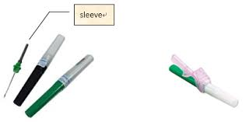
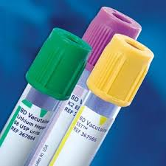
Phlebotomy
Equipment for routine venipuncture:
Double-pointed safety needles
Evacuated stoppered tubes

Slide 7
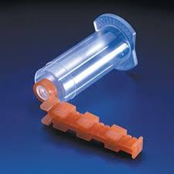
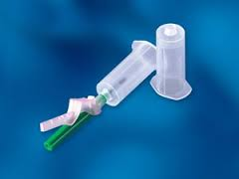
Phlebotomy
Phlebotomy Equipment
Needle holder
Sharps container
Syringes
Winged infusion sets (butterfly needles)
Tourniquet
Marking pen
Alcohol swabs
Gauze pads
Bandages
Gloves

Slide 8
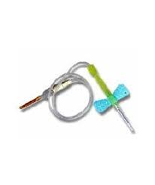
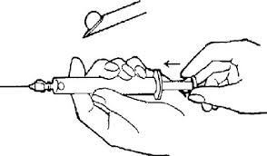
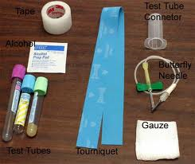
Phlebotomy

Slide 9
Phlebotomy
Equipment
Gloves
Employers must provide employees gloves including the hypoallergenic, powderless and vinyl types as needed.
Always ask patients about latex allergy
Use latex free if patient has allergies
Most facilities now provide only latex free equipment; tourniquets, gloves, and bandages.
OSHA
Requires healthcare workers to wear gloves during venipuncture.
Does not specify when during the course of the procedure the globes must be put on.
Because veins can be difficult to locate with gloved fingertips, the site may be palpated before gloves are put on
Standards establish by Clinical and Laboratory Standards Institutes (CLSI) states that gloves should be put on after vein palpitation but before preparation of site.
Notes:
One last palpation before the needle is inserted must remember that touching the prepared site, even with gloves, contaminates the area. Help in finding the vein after cleansing the area, one should make note of creases, freckles or scars. If the area is touched, it must be cleansed again. Keep in mind the tourniquet should be tied for no longer than 1 minute.

Slide 10
Phlebotomy
Equipment
Tourniquets:
Helps in locating the vein.
Prevents venous flow out of the site, causing the veins to bulge.
Tied around the upper arm so that it is tight but not uncomfortable and can be released easily with one hand.
Tourniquets can be made of latex (can become contaminated with frequent use of risk of allergy). Some can use Velcro for closure. Velcro may be more comfortable for the patient but are difficult to release. Single use nonlatex tourniquets are available and currently are recommended for reducing cross-contamination between patients and healthcare workers, thus preventing nosocomial infections and latex exposure.
NOSOCOMIAL = disease originating in a hospital or medical facility.

Slide 11
Phlebotomy
Equipment
Tourniquets: Tied 3-4 inches above the elbow immediately before the venipuncture procedure begins.
Because tourniquets impedes blood flow, leaving it on for longer than 1 minute greatly increases the possibility of Hemoconcentration and altered tests results.
Tourniquet should not be tied so tightly as to impede arterial blood flow; this restricts venous blood return, resulting in poor venous distention. Checking pulse at the wrist ensures that arterial flow is not restricted.
Tourniquets also are used when blood is drawn from hand and foot veins and are tied on the wrist or ankle respectively.

Slide 12
Phlebotomy
Tourniquets
Can be uncomfortable for the patients if not applied correctly.
Make sure they are flat against the skin and if necessary tie it over the clothing. Be aware also of elderly patients as their skin may be fragile.
Antiseptics
To prevent infection; site must be cleansed with an antiseptic.
Commonly used 70% isopropyl alcohol; common name rubbing alcohol.
Prep pads individually wrapped
Alcohol is rubbed on the skin in a circular motion, then allowed to dry.
Alcohol does not sterilize the skin; it inhibits the reproduction of bacteria that might contaminate the sample.

Slide 13
Phlebotomy
Antiseptics
Alcohol should remain on the skin 30-60 seconds to be most effective.
Isopropyl alcohol should not be used when a sample for a blood alcohol test is drawn.
Sterile soap pads, benzalkonium chloride or povidone-iodine (Betadine) can be used instead.
For blood cultures; additional preparation is needed at the venipuncture site to eliminate contaminating bacteria.
Povidone-iodine solution commonly is used, and chlorhexidine gluconate or benzalkonium chloride can be used for patients allergic to iodine.
More vigorous cleaning is required for a blood culture sample than for a routine venipuncture.
Blood cultures must be drawn into a sterile tube or a bottle specifically designed for the test.

Slide 14
Phlebotomy
Collection containers
Vacuum Collection Tubes
Tubes have been evacuated (the air has been removed to create a vacuum) so that a preset amount of blood will be collected.
Available in different sizes ranging from 2-15 mL of blood. (5,7,15) for adults and 2,3and 4 mL for pediatrics.
Tubes are available in glass and plastic, however, OSHA recommends using plastic tubes for safety reasons. Additionally , the state of California also requires the use of plastic tubes.
Manufacturer’s tube labels on each tube indicates the type of anticoagulant or additive present, the expiration date of the tube and the amount of blood it will hold.
Some tubes are designed with a special rubber stopper surrounded by a plastic closure that hangs over the outside of the tube and reduces the risk of blood splattering when the stopper is removed. (BD Hemoguard plastic tubes).

Slide 15
Phlebotomy
Equipment
Vacuum tubes
Expiration date should always be checked and the tubes examined for cracks and other damage before use. If air should get into the tube, the tube would be rendered useless because no blood would flow into it.
Each tube has a colored stopper and label that indicates whether anticoagulants or additives are present and their type.
No additive = clotted blood’ yellow substance product from clotted blood is serum.
Blood usually clots in 30 – 45 min at room temperature.
May also have additive that accelerate clotting such as silicone and glass beads.
Anticoagulants added = blood is prevented from clotting. The cells are suspended in a liquid referred to as plasma.

Slide 16
Phlebotomy
Equipment
Anticoagulant tubes; Blood will not clot and can be used for testing when whole blood is needed.
When whole blood is centrifuged, the red cells pack into the bottom of the tube. The buffy coat is the narrow middle layer of white blood cells and platelets in the centrifuged whole blood specimen and the liquid layer on top is referred to as plasma.
Anticoagulation occurs by using a variety of additives, such as oxalates, citrates, EDTA and heparin. Oxalates, citrates, and EDTA bind with calcium which is needed for clotting to occur. Heparin prevents clotting by inactivating thrombin and thromboplastin, the proteins needed in the blood-clotting mechanism.
Another common additive is the white gel (Thixotropic gel) that forms a barrier between the cells and the liquid serum or plasma depending on the tube to stop further interaction between these layers. When this gel is in a clot tube; it is referred to as a SST (serum separator tube). When in whole blood tube a PST (Plasma Separator Tube).

Slide 17
Phlebotomy
Equipment
Vacuum tubes: The different types of anticoagulants and additives within the vacuum tubes are differentiated by the following color-coded plastic stoppers.
Pale yellow – Sterile tubes containing preservatives and or nutrients, used for growing blood cultures.
Light blue – contains liquid sodium citrate anticoagulant, used for coagulation testing. (prothrombin time)
Red – contains no anticoagulants, which means the blood will automatically clot. Red plastic tubes contain a clot activator to accelerate the clotting process.
Gold – contains a silicon coating to accelerate clotting and a gel barrier to separate the serum from the cells (SST tube) Contains no anticoagulant. The serum is typically used for blood chemistries.

Slide 18
Phlebotomy
Vacuum tubes
Green – contains a heparin anticoagulant: sodium heparin, lithium heparin or ammonium heparin: used for chemistry specimens, especially when a test is stat because waiting for the blood to clot is not necessary as it is with serum tubes. NOTE: Important to know the type of anticoagulant substance that is in a heparin tube (sodium heparin tube would not be used for sodium testing nor a lithium heparin tube be used for lithium testing because the substances would falsely raise the levels when tested. Ammonium heparin is often used with a gel and the tube is termed a PST.
Lavender – contains EDTA which acts as an anticoagulant and preservative for blood cells; used for hematology studies and molecular diagnostic testing. EDTA prevents platelet aggregation and allows preparation of blood smears with minimal distortion of white blood cells.

Slide 19
Phlebotomy
Equipment
Vacuum tubes:
Gray – contains potassiumoxalate / sodiumfluoride anticoagulant, which removes calcium to prevent clotting; used for glucose studies because the fluoride inhibits glycolysis (sugar breakdown)
NOTE: The color order of the tubes just described is the same order in which they are collected.
Vacutainer Needle:
Pointed at both ends. The shorter end punctures the vacuum tube, and the longer end has a bevel that is inserted into the vein. For a smoother and less painful puncture, the bevel end should always be turned upward.
Safety needles are now required by law.
Needle length is 1 to 1.5 inches.
Space inside the needle (lumen or bore). The diameter of the needle is referred to as the gauge. The higher the gauge the smaller the diameter. Frequently used gauge for phlebotomy is 20 -22. A higher gauge could cause hemolysis because lumen is too small.

Slide 20
Phlebotomy
Equipment
Vacutainer holder:
Plastic sleeve that allows the tube to connect to the needle.
The double pointed needle screws into one end of the holder.
After the needle is inserted into the patient’s vein, the tube is pushed all the way into the holder.
Two types are available. One for children and one for adults.
A plastic extension or flange, is located at the large-opening end of the holder. This design prevents the holder from rolling and provides a lip on which to position the fingers as the tube is inserted and removed.
OSHA recommends that Vacutainer needles not be removed from the holder after use but instead be disposed of with the holder attached because the rubber stoppered neelde can expose health care workers to needle sticks.

Slide 21
Phlebotomy
Equipment:
Syringe method:
Used on fragile veins that might collapse under the pressure of the vacutainer method.
Procedure is similar to vacuum method except when the needle is in the vein the phlebotomist pulls back on the syringe plunger creating the back pressure and drawing blood into the syringe.
More control over pressure upon veins makes it best for small fragile veins.
Syringe:
Consists of a barrel and a plunger
Barrel is graduated into milliliters in sizes ranging from 2-20 mL
Plunger should always be moved back and forth to loosen before use.

Slide 22
Phlebotomy
Syringe needle:
Also called a hypodermic needle.
Like the vacutainer needle it has a shaft and a hub, but the hub attaches directly to the syringe with no opposing sheathed needle.
Blood can be seen entering the tip of the syringe as soon as the needle goes into the vein.
Syringe needles must have a safety section that allows the needle to be covered or blunted when the procedure is complete.

Slide 23
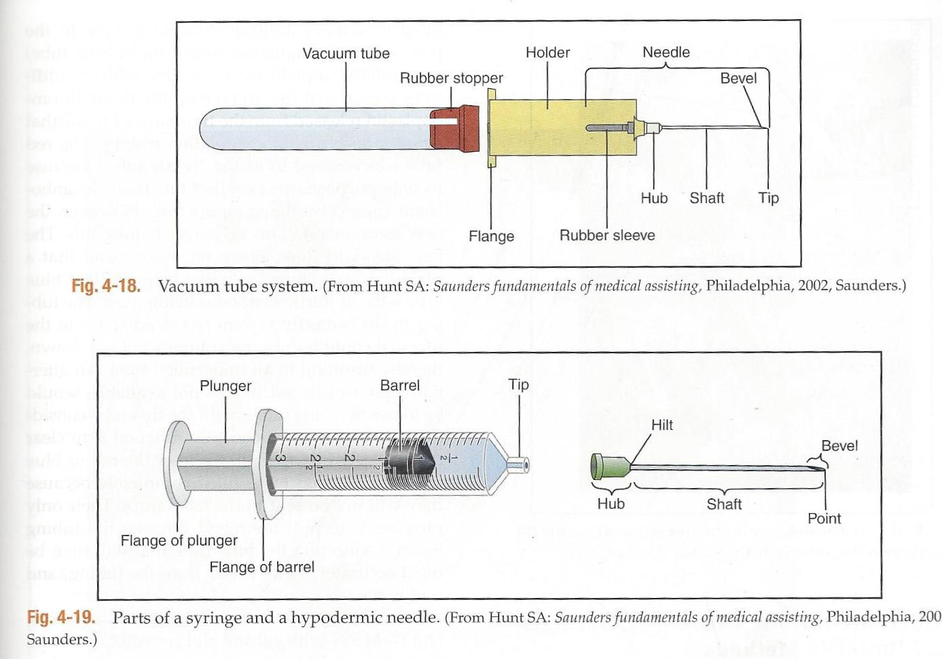
Phlebotomy

Slide 24
Phlebotomy
Butterfly method
Used for very small veins, such as those in the hand, and for pediatric draws.
The equipment consists of a uniquely designed needle with a safety sheath and plastic wings (used to grip the needle as it is inserted into the vein), tubing, and devices to attach to either a syringe or a vacutainer collection system.
Activating the safety device for the needle after completion of the phlebotomy can be tricky. It is recommended to practice with the device prior to performing phlebotomies with this method.

Slide 25
Phlebotomy
Steps for performing a phlebotomy
Always maintain professionalism; Clean laboratory coats or scrubs.
Maintain confidence with patient and communication skills.
Acquire requisition
Select the proper method for venipuncture (syringe, vacutainer, butterfly
Prepare the patient
Greet and Identify patient: CSLI recommends for outpatients ask patients to provide first and last name. address, and an identification number or birthdate. Compare to written information on requisition.
Inpatients ask same information and compare to arm band and requisition.
Introduce yourself and briefly explain the purpose and procedure of the venipuncture.

Slide 26
Phlebotomy
Venipuncture procedure:
Answer any questions the patient may have. If they are about the tests ordered politely request that the patient speak to the physician and if patient would like to do so before collecting the specimen.
Obtain verbal consent to perform the procedure simply by asking whether you have permission to take some blood from the patient’s arm.
Always ask if patient has experienced problems with venipunctures in the past and take steps to prevent such problems.
Refer to patient as “sir” or “ma’am” or Mr jones or Ms Smith.

Slide 27
Phlebotomy
Preparing for the Venipuncture
Seat patient in a chair or lie down on an examination table if they have a history of syncope.
Ask patient to extend both arms. Inspect both arms and ask whether the patient has a preference.
Venipuncture is usually performed in the antecubital area.
Site should be carefully selected after both arms have been inspected.
Do not use sites that are cyanotic, scarred, bruised, edematous or burned. Alternative sites may be used. Consult text.
Apply a tourniquet 3-4 inches above the patient’s elbow, making sure it is not twisted.

Slide 28
Phlebotomy
Preparing for the venipuncture
Grasp the tourniquet ends, one in each hand, at the part of the tourniquet that is closest to the patient’s skin. Pull the ends apart to stretch the rubber material, then cross on end over the other while maintaining the tension.
Tuck the top end of the tourniquet underneath the bottom piece, creating a loop with the upper flap free so it can be released with one hand.
The tourniquet should be tight without being twisted or pinching thepatient’s skin. Both ends of the tourniquet should be pointing upward so that they do not contaminate the blood draw site.

Slide 29
Phlebotomy
Preparing for venipuncture
Ask the patient to make a fist and palpate for an acceptable vein using your ungloved index finger.
Veins bounce lightly when palpated.
Veins of choice: Medial veins: generally run parallel or at a slight angle to the fold in the antecubital area.
Cephalic veins: run lateral or to the outside of the antecubital area.
The basilic vein , which lies on the inside part of the antecubital area, is very close to the brachial artery and median nerves and should be used only if the medial or cephalic veins are inaccessible.

Slide 30
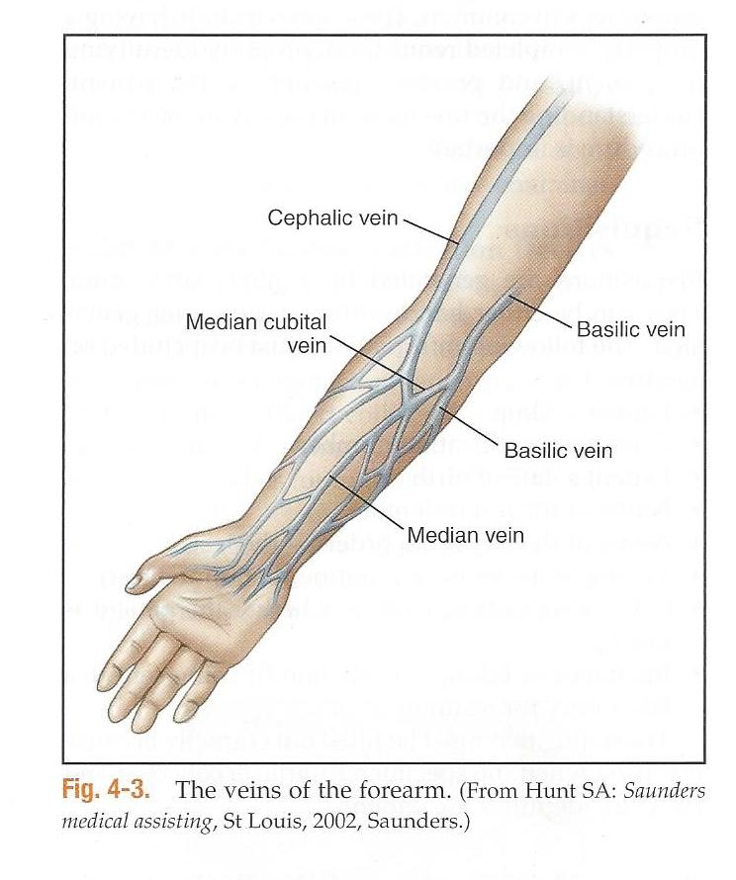
Phlebotomy

Slide 31
Phlebotomy
Performing the Venipuncture
Once vein is located remove the tourniquet. Remember it can only be in place for 1 minute. Wait 2 minutes before reapplying it.
Assemble your equipment, making sure it is within easy reach, that the sterile packets are torn open and that the contents are easily accessible.
Sanitize your hands.
Reapply the tourniquet and quickly relocate the ein.
Put on gloves and cleanse the area with the alcohol, working outward in a circular motion. Do not touch area after cleansing.
Ask the patient to clench their fist; do not have them pump as this may temporarily increase the level of potassium and ionized calcium in the blood.

Slide 32
Phlebotomy
Performing the venipuncture:
Anchor the vein by stretching the skin downward below the collection site with the thumb of the nondominant hand and swiftly insert the needle into the vein at a 15-degree angle.
The bevel of the needle should be facing up.
If the needle is inserted at an angle greater than 15 degrees, it quickly penetrates the other side of the vein and enters other structures, such as nerves or the brachial artery, and very likely will cause a hematoma or an injry.
Pull back on syringe plunger or push the evacuated tube into the double pointed needle.
Once blood enters the tube or barrel, ask the patient to unclench the fist.

Slide 33
Phlebotomy
Completing the venipuncture
Continue to draw the specimen(s) as needed to complete the test order.
Check the patient’s condition periodically.
As you remove each tube from the needle holder, gently invert it several times before pacing in the rack.
Tubes with clot activator should be inverted 5 times, light blue tubes for coagulation studies should be inverted 3 or 4 times and all other anticoagulated tubes 8-10 times.
With the last tube filling release the tourniquet without jarring the needle, and remove the final tube.
Remove the needle quickly and apply gauze with pressure to the puncture site.

Slide 34
Phlebotomy
Completing the venipuncture:
Ask the patient to continue applying pressure but do not bend the arm.
Immediately activate the safety device to cover the needle and dispose of the entire needle / needle holder unit into the sharps container.
Before applying bandage perform a two-point check to make sure the vein is not leaking.
Observe the site for 5-10 seconds after releasing pressure. If visible bleeding occurs, or if the tissue around the puncture site rises, continue applying pressure until the bleeding has stopped.
Put on bandage and dispose of the gauze in a biohazard waste container.
Clean gauze, not a cotton ball can be taped over the site in lieu of a bandage.

Slide 35
Phlebotomy
Completing the venipuncture:
Label all tubes by the patient’s side. Never leave the room or release an outpatient until the tubes have been labeled.
Assess the patient’s status one last time, then dismiss the patient.
Be sure to record procedure on chart.

Slide 36
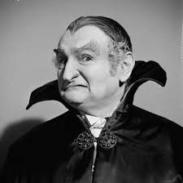
The End

