Slide 1
Blood Collection
Vocabulary

Slide 2
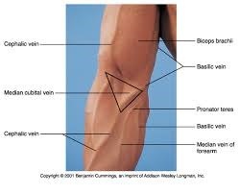
Blood Collection
Antecubital space:
Area in front of the elbow

Slide 3
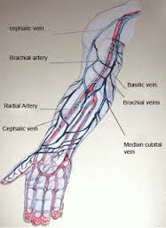
Blood Collection
Arteries:
Blood vessels that carry blood away from the heart.

Slide 4
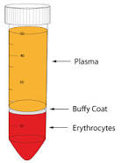
Blood Collection
Buffy coat:
Narrow middle layer of white blood cells and platelets in a centrifuged whole blood specimen.
Whole blood: anticoagulant has been added to sample to prevent clotting.

Slide 5
Blood Collection
Capillaries:
Microscopic blood vessels that contain a mixture of arterial and venous blood.

Slide 6
Blood Collection
Cyanotic:
A condition in which the skin and mucous membranes are blue ,caused by an oxygen deficiency

Slide 7
Blood Collection
Edema:
Abnormal collection of fluid in interstitial spaces.

Slide 8
Blood Collection
Evacuate:
To remove air to produce a vacuum

Slide 9
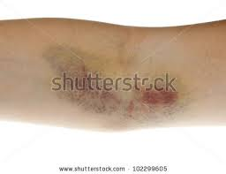
Blood Collection
Hematoma
Tumor or swelling of blood in the tissue (resulting in bruising during blood collection procedures)

Slide 10
Blood Collection
Hemoconcentration:
Condition in which blood concentration of large molecules such as proteins, cells and coagulation factors increase.

Slide 11
Blood Collection
Humors:
Fluid or semifluid substances found in the body.

Slide 12
Blood Collection
Interstitial fluid
All the fluid except blood that is found in the space between tissues, also referred to as tissue fluid.

Slide 13
Blood Collection
Lumen:
Inner tubular space of a needle, vessel or tube.

Slide 14
Blood Collection
Microcollection
Collecting a small amount of blood

Slide 15
Blood Collection
Osteomyelitis:
Inflammation of the bone caused by bacterial infection.

Slide 16
Blood Collection
Palpating:
Gently touching and pressing down on an area to feel texture , size and consistency.

Slide 17
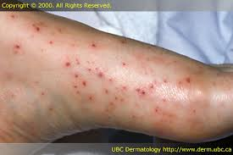
Blood Collection
Petichiae:
Tiny purple or red skin spots caused by small amounts of blood under the skin found in those with coagulation problems; condition can lead to excessive bleeding during phlebotomy procedures.

Slide 18
Blood Collection
Phlebotomy:
Blood collection; derived from the Greek words phlebo, meaning vein and tomy meaning to cut.

Slide 19
Blood Collection
Plasma:
Liquid part of whole blood

Slide 20
Blood Collection
Serum
Liquid part obtained when blood is clotted; lacks clotting factors.

Slide 21
Blood Collection
Syncope
Fainting

Slide 22
Blood Collection
Veins:
Blood vessels that carry blood towards the heart.

Slide 23
Blood Collection
Hemolysis:
The destruction or dissolution of red blood cells, with subsequent release of hemoglobin.

Slide 24
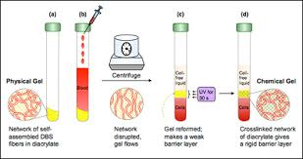
Blood Collection
Thixotropic gel:
A material that appears to be a solid until subjected to a disturbance such as centrifugation, whereupon it becomes a liquid.

Slide 25
The End

