Slide 1
UA Specialty Testing

Slide 2
UA Specialty Testing
Clinitest
Chemistry strip detects only glucose.
Sugars other than glucose may exist.
Metabolic disorders can result in excretion of sugars such as galactose, fructose, lactose, maltose, or pentoses.
Galactosemia described previously
Of the many sugars mentioned glucose or galactose signifies a pathologic condition.

Slide 3
UA Specialty Testing
Clinitest
Chemical reduction of copper, is commonly used to screen and confirm glycosuria and to detect other sugars in urine.
Reducing substances can chemically convert curic sulfate to cuprous oxide, resulting in a color change. A sugar’s reducing abilities is determined by the presence of a “chemical reducing group” present in all monosaccharides.

Slide 4
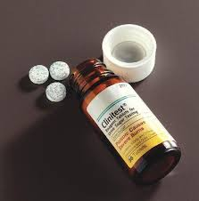
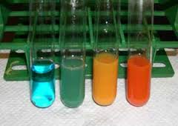
UA Specialty Testing
Consult text for performance of Clinitest testing

Slide 5
UA Specialty Testing
Acetest
Acetest reagent tablets provide an alternative to strip testing when urine must be tested for the presence of ketones.
Based on same chemical reaction as the reagent strip test, however, the advantage lies in the fact that the tablet can be used with specimens other than urine and it detects both acetone and acetoacetate.

Slide 6
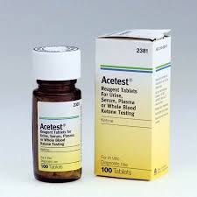
UA Specialty Testing

Slide 7
UA Specialty Testing
Urine pregnancy testing
Detects the presence of human chorionic gonadotropin (hCG) a hormone produced by the placenta and present in urine during pregnancy.
After implantation of the fertilized egg in the uterus the hCG levels in serum double every few days. This rise occurs for approximately 7 weeks and then begins to diminish.
Most common pregnancy test is the lateral flow immunoassay.

Slide 8
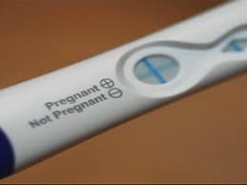
UA Specialty Testing
First morning specimen best for pregnancy test
Test based on reactions that occur between antibodies and antigens.
Refer to text for performance of the test.

Slide 9
UA Specialty Testing
Ovulation testing
CLIA waived ;atera; f;pw irome tests are available to assist in the prediction of ovulation for women attempting to conceive either naturally or using artificial insemination.
Luteinizing hormone (LH) remains at a relatively stable level. Approximately 14 days before menstruation, the body experiences the “LH surge”

Slide 10
UA Specialty Testing
Ovulation testing
Surge triggers the release of ovum from the ovary,
Conception is most likely to occur within 36 hours after the LH surge.
Principle of test similar to pregnancy test.
Test is performed for 5 consecutive days in the middle of the cycle. Once the surge is detected, ovulation can be expected within 2-3 days.

Slide 11
UA Specialty Testing
Menopause testing
Follicle-stimulating hormone (FSH) is produced by pituitary gland. When a woman enters menopause, the ovaries stop producing eggs and the levels of FSH rises.
Lateral flow tests detect FSH in urine. A positive test may indicate the stage of menopause. A negative test result along with symptoms of menopause, may indicate a woman is in perimenopause.
Qualitative test should never be used to direct a woman to stop using birth control methods if she does not want to comceive, because pregnancy is still possible during perimenopause.

Slide 12
UA Specialty Testing
Urine toxicology
Urine is the specimen of choice for most routine screening procedures.
A random specimen needed
Safeguards used to ensure that a specimen is fresh and is truly from the patient.
Some cases a strict chain of command may be necessary.

Slide 13
UA Specialty Testing
Urine toxicology
Substance or its metabolite often remains in the urine much longer than the impairment or intoxication lasts. This is one reason urine screening is favored over serum or bloode screening.
MA may be responsible for collecting specimens for toxicology tests and for performing certain tests.

Slide 14
UA Specialty Testing
Consult text for specifics of specialty testing.
Alcohol testing is not performed on urine, but CLIA – waived tests are available to detect alcohol using saliva. Saliva-based tests have a high degree of correlation to blood alcohol analysis.
Culturing of urine performed to assist in the diagnosis of UTI and to assess the effectiveness of certain antibiotics in treatment of the infection.

Slide 15
UA Specialty Testing
Patient education
Responsibility of MA

Slide 16
The End

