Slide 1
UA Microscopic Exam

Slide 2
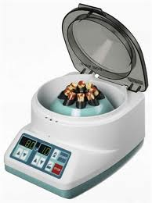
UA Microscopic Exam
Use a well mixed urine specimen
Pour about 10 mL into a labeled centrifuge tube and cap.
Place specimen in centrifuge; be sure the tube is balanced by another tube in centrifuge.
Secure the lid and spin for 5 minutes.

Slide 3
UA Microscopic Exam
Remove the tube from the centrifuge after the instrument as come to full stop.
Pour off the clear supernatant from the top of the specimen by inverting the tube over the sink drain. DO NOT TURN THE TUBE UPRIGHT UNTIL THE SUPERNATANT HAS BEEN FULLY DECANTED.

Slide 4
UA Microscopic Exam
Sediment remaining in the tube will be examined under the microscope

Slide 5
UA Microscopic Exam
Thoroughly mix the sediment by grasping the tube near the top and rapidly flicking it with the fingers of the other hand until all sediment is thoroughly resuspended.
Transfer one drop of sediment to a clean, labeled slide using a clean, disposable transfer pipette.

Slide 6
UA Microscopic Exam
Transfer one drop of sediment to a clean, labeled slide using a clean, disposable transfer pipette.
Place a clean coverslip over the drop and place the slide on the microscope stage. The remaining steps are usually performed by healthcare practitioner. Medical Assistants should not perform the microscopic exam unless specifically trained.

Slide 7
UA Microscopic Exam
Casts:
Formed when protein accumulates and precipitates in the kidney tubules and is washed into the urine.
Protein takes on size and shape of the tubules.
Cylindric ,with flat or rounded ends, and are classified according to the substances observed in them.
Certain types are associated with renal pathologic conditions others are physiologic and are generally caused by strenuous exercise.

Slide 8
UA Microscopic Exam
Casts:
Are counted and reported under low-power magnification: occasionally high-power magnification is needed to identify the type.
Closely examine edges of coverslip
Sediment may be stained with a supravital stain to give greater contrast to formed elements……Most common is Sternheimer-Malbin stain consisting of crystal violet and safranin….”Sedistain”.

Slide 9
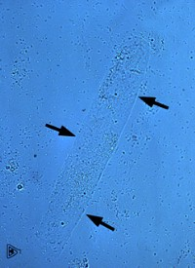
UA Microscopic Exam
Focus under low power and reduce the light.
First scan the entire coverslip for abnormal findings.
Examine at least 5 low-power fields.
Count and classify each type of cast seen, if any.
Hyaline casts: are pale transparent, cylindric and have rounded ends and parallel sides. Missed if light not reduced at the condenser.
Notes:
Mucus and casts are easily missed if reduced light is not used. Constant focusing helps locate casts.
Casts tend to migrate to the edges of the coverslips.

Slide 10
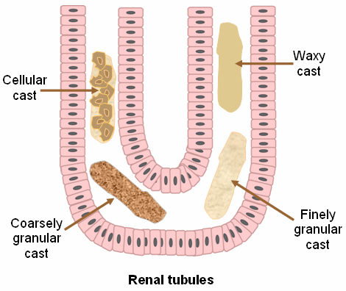
UA Microscopic Exam
Cast formation in renal tubules.

Slide 11
Hyaline casts:
Formed when urine flow through individual nephrons is diminished.
Also can be found in urine of individuals with kidney disease but also in the urine of people without such disease who have exercised heavily.
Occasionally hyaline casts have granular or cellular inclusions.

Slide 12
UA Microscopic Exam
Cellular casts most commonly result when disease processes such as ischemia, infarction, or nephrotoxicity cause degeneration and necrosis of tubular epithelial cells. The presence of these casts indicates acute tubular injury but does not indicate the extent or reversibility of the injury.
White blood cell casts are hyaline casts that contain leukocytes.. Usually seen in pyelonephritis. WBC are multilobed whereas renal tubular cells are single round nucleus.

Slide 13
UA Microscopic Exam
Granular casts, as the name implies, have a textured appearance which ranges from fine to coarse in character.
Finely and coarsely granular casts may be caused by exercise, but the presence of increased numbers may indicate renal disease.

Slide 14
UA Microscopic Exam
Fatty casts are identified by the presence of refractile lipid droplets. The background matrix of the cast may be hyaline or granular in nature. Often, they are seen in urines in which free lipid droplets are present as well. Fatty casts are the most common type seen in cat urines. Interpretation of the significance of "fatty" casts should be based on the character of the cast matrix, rather than on the lipid content per se.

Slide 15
UA Microscopic Exam
Waxy casts have a smooth consistency but are more refractile and therefore easier to see compared to hyaline casts. They commonly have squared off ends, as if brittle and easily broken. Waxy casts indicate tubular injury of a more chronic nature than granular or cellular casts and are always of pathologic significance.

Slide 16
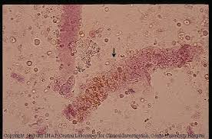
UA Microscopic Exam
Red Blood Cell Casts
Hyaline casts with embedded red cells. Their presence indicates damage to the glomerular membrane. They may appear brown as a result of the color of the red blood cells.

Slide 17
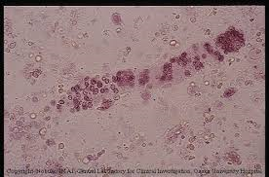
UA Microscopic Exam
Renal tubular epithelial cells:
Easily confused with WBC casts especially if cells have started to degenerate. Renal tubular epithelial cell casts are found when excessive damage has occurred. Causes are shock, renal ischemia, heavy-metal poisoning; certain allergic reactions and nephrotoxic drugs.

Slide 18
UA Microscopic Exam
Switch to high-power magnification and adjust the light.
Other sediment findings include:
Cells
Crystals
Micro-organisms; fungus

Slide 19
UA Microscopic Exam
Cells:
Include: epithelial cells derived from the lining of the genitourinary tract; red blood cells and white blood cells from the bloodstream.
Cells are classified and counted under high-power magnification.
RBCs may enter the urinary tract at any point of inflammation or injury. May be found in normal urine in small numbers 1 – 2 per high-power field.

Slide 20
UA Microscopic Exam
RBCs:
RBCs are pale, round, nongranular, and flat or biconcave.
Smaller than WBCs and have no nucleus.
In hypotonic (dilute) urine they swell and burst.
In hypertonic (concentrated) may crenate and wrinkle.
May be confused with yeast, oil droplets, and droplets of lens cleaner.

Slide 21
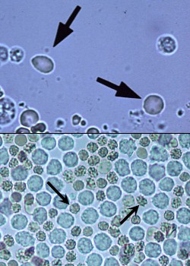
UA Microscopic Exam
Hematuria: Presence of RBCs

Slide 22
UA Microscopic Exam
WBCs (Leukocytes)
May be found in normal urine; increased numbers (more than 5 cells per high-power field) associated with inflammation or contamination.
Larger than RBCs and have a granular appearance and usually multilobed nucleus; usually neutrophils.

Slide 23
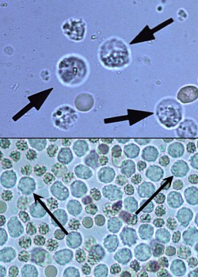
UA Microscopic Exam
WBCs
Most WBCs in urine are Neutrophils. Not to be confused with Renal tubular or round epithelial cells.

Slide 24
UA Microscopic Exam
Renal tubular or round epithelial cells:
Larger than WBCs
Round or oval
Nucleus that is single, large, oval and sometimes eccentric.
Few may be found in normal urine but their presence is increased numbers indicates tubular damage.

Slide 25
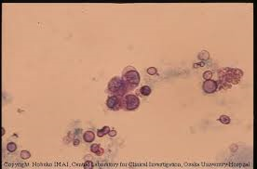
UA Microscopic Exam
Renal Tubular Epithelial Cells

Slide 26
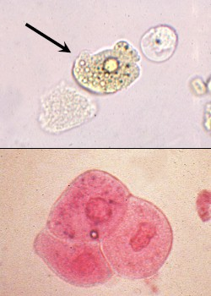
UA Microscopic Exam
Transitional Epithelial Cells:
Transitional epithelial cells originate from the renal pelvis, ureters, urinary bladder and/or urethra. Their size and shape depends on the depth of origin in the mucosa. Most often they are round or polygonal; less commonly pear-shaped, tailed, or spindle-shaped. They are generally somewhat smaller and smoother in outline than squamous cells, but larger than WBC. They may develop refractile, fatty inclusions as they degenerate in older specimens.

Slide 27
UA Microscopic Exam
Squamous Epithelial Cells:
In the lower portion of the genitourinary tract.
Present in large numbers in female patients usually indicates vaginal contamination.
Squamous epithelial cells are large, flat irregular cells and are easily recognized under low-power.
Have a single, small, round, centrally located nucleus and often occur in sheets or clumps.
Edges of the cells are often rolled or folded.

Slide 28
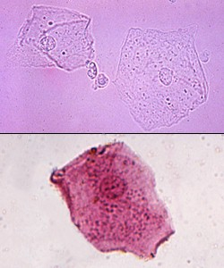
UA Microscopic Exam
Squamous epithelial cells
Identifying epithelial cells: helpful to remember the appearance of eggs; round epithelial cells resemble hard-boiled eggs that have been cut in half. Transitional forms resemble poached eggs and squamous cells resemble fried eggs with large, runny whites.

Slide 29
UA Microscopic Exam
Crystals:
Are common in urine specimens, particularly if the specimen has been allowed to cool.
Cooling causes the solid crystals to precipitate out of the urine.
Usually not clinically significant unless found in large numbers.
Abnormal crystals are seen in acidic urine.
May be metabolic in origin
Present because of certain disease states or inherited metabolic conditions.

Slide 30
UA Microscopic Exam
Crystals:
Abnormal crystals:
May be of iatrogenic (of or relating to illness caused by medical examination or treatment) origin and are present as a result of medication or treatment.

Slide 31
UA Microscopic Exam
Identification of Crystals:
Begins with determination of the pH of the urine to ascertain whether the sample is acidic or alkaline.
Next Color, shape and refractivity observed.
Use of phase or polarized microscope or using supravital stain can assist in ID
History of medication intake and recent diagnostic testing.
Crystals are identified with lo-power and high-power lenses and their presence is reported as occasional, few, moderate or many per HPF

Slide 32
UA Microscopic Exam
Crystals:
Amorphous
Amorphous urates are salts of uric acid and are seen as shapeless granulation in acidic urine.
Amorphous phosphates are found in alkaline urine and are seen as fluffy white precipitate.
Profuse and can obscure other formed elements in the sediment.
Frequently are difficult to identify without additional chemical testing, such as solubility testing in acid and base.

Slide 33
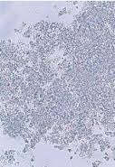
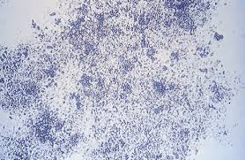
UA Microscopic Exam
Amorphous Crystals:
Amorphous phosphates alkaline urine
Amorphous urates acidic urine

Slide 34
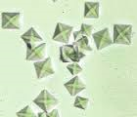
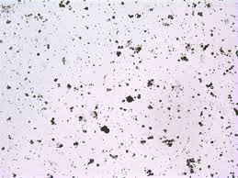
UA Microscopic UA
Normal Crystals acid urine.
Calcium oxalate crystals
Uric acid crystals

Slide 35
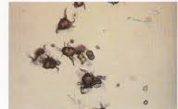
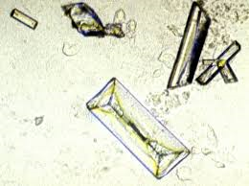
UA Microscopic Exam
Normal Crystals Alkaline urine
Ammonium biurate crystals; yellow brown “thorny apples” Will convert to uric acid when acetic acid is added.
Triple phosphate crystals

Slide 36
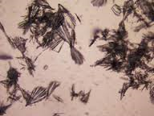
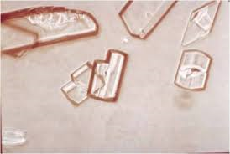
UA Microscopic Exam
Abnormal Crystals:
Sulfonamide crystals
Cholesterol crystals.

Slide 37
UA Microscopic Exam
Miscellaneous findings:
Oval fat bodies: formed when renal tubular epithelial cells or macrophages absorb fats.
Vary in size and are refractive.
Characteristic of nephrotic syndrome and distinguished by using Sudan III stain
Yeast: May indicate vaginal contamination or infection of the urine with yeast.
Common in urine of diabetics
Can be confused with RBCs; usually are oval and show budding.

Slide 38
UA Microscopic Exam
Miscellaneous Findings:
Bacteria: A few present may be normal. Heavy bacterial concentrations in the absence of WBC may indicate that the specimen was allowed to sit at RT and bacteria multiplied.
Specimens with a putrid odor and numerous WBCs and bacteria are common with UTIs.
May be bacilli (rod shaped) or cocci (spheric)
Often motile and can be identified under low and high power.

Slide 39
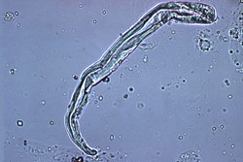
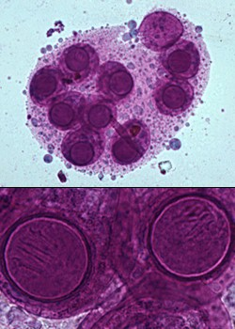
UA Microscopic Exam
Miscellaneous Findings
Urine contaminant fiber
Fecal parasites Fecal material, including eggs of intestinal parasites, sometimes contaminates voided urine samples.

Slide 40
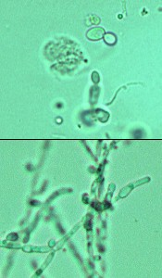
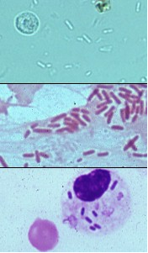
UA Microscopic Exam
Miscellaneous Findings:
Yeast; Candida
Bacterial Infection

Slide 41
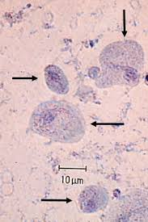
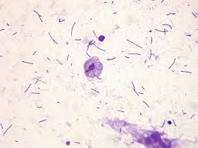
UA Microscopic Exam
Parasites: Most common Trichomonas vaginalis

Slide 42
The End

