Slide 1
Routine Urinalysis

Slide 2
Routine Urinalysis
Patient Preparation
Request may be embarrassing for patient…….be sensitive
Make request in private in exam room
Give explicit instructions for patient to understand process and what to expect.
MA should use therapeutic communication to explain the details of the procedure to the patient and be observant of confusion.
Language barriers if they exist

Slide 3
Routine Urinalysis
Container
Important for collection container to be scrupulously clean
Laboratory should provide specimen container
Patient should not use jars from home
Disposable, nonsterile, plastic or coated paper containers are the most common and are available in many sizes with tight fitting lids
For C&S container must be sterile; and patient must be instructed on how to collect the specimen and how to handle the sterile specimen cup.
Pliable polyethylene bags with adhesive are used to collect urine from infants and children who are not toilet trained.
For timed or 24 hour specimens a large, wide mouth plastic container with screw-cap tops are used.
Most routine UA testing, pregnancy testing and tests for abnormal analytes are performed on urine collected in non sterile containers.

Slide 4
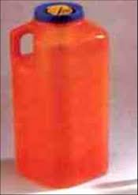
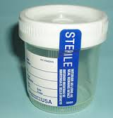
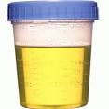
Routine Urinalysis
Containers
Pediatric collection
24 hour urine container
Sterile collection for C&S
Non sterile container

Slide 5
Routine Urinalysis
Methods of Specimen Collection:
Random specimen: freshly voided urine collected in clean containers.
First morning specimen: Collected when the patient arises in the morning.
Most concentrated and best for nitrite and protein determination, bacterial culture, pregnancy testing and microscopic examination.
2 Hour post-prandial urine specimens: Collected 2 hours after a meal
Used for diabetes screening and for home diabetes testing programs.
24 hour urine specimen – collected over a 24 hour period
Useful for quantitative chemical analysis such as hormone levels and creatinine clearance rates (evaluation of glomerular filtration rate of the kidneys)

Slide 6
Routine Urinalysis
Methods of collection:
Clean catch mid-stream specimen (CCMS) useful for UA and C&S
Catheterized specimens – Physician, PA, Nurse must insert a sterile catheter into bladder to collect specimen.
Suprapubic specimen: collected with needle inserted directly into the bladder.
Specimen
Minimum volume = 12mL but 50mL is preferred.
Imperative patient receive adequate verbal and / or written instructions.
Rule of thumb or easiest directions for the patient are to ask the person to “Fill the container halfway”.

Slide 7
Routine Urinalysis
Handling and Transport of Specimens
Chemical and cellular components of urine change if the urine is allowed to stand at room temperature (RT).
Specimens refrigerated and processed within 1 hour of collection.
NOTE: Specimen must come to RT when testing with chemistry strips as some of the elements are temperature dependent.
Transported specimens to a referral lab – specimens transported in evacuated transport tubes which contains preservatives and look similar to blood collection tubes. 7-8 mL of urine can be collected into the tubes.

Slide 8
Routine Urinalysis
Changes in Urine at RT
Clarity Becomes cloudy as crystals precipitate and bacteria multiply
Color May change if pH becomes alkaline
pH Becomes alkaline as bacteria form ammonia from urea
Ketones Decrease because of evaporation
Bilirubin /urobilinogen
Blood May hemolyze; false positive results are possible because of bacterial peroxidase
Nitrite May become positive as bacteria multiply and reduce nitrate.
Casts Lyse or dissolve in alkaline urine
Cells Lyse or dissolve in alkaline urine

Slide 9
Routine Urinalysis
Bacteria Multiply twofold approximately every 20 minutes
Yeasts Multiply
Crystals Precipitate as urine cools; may dissolve if pH changes.

Slide 10
Routine Urinalysis
Physical Examination of Urine
Appearance
Color – Shade of yellow, ranging from pale straw to yellow to amber.
Depends on the concentration of pigment Urochrome and amount of water in specimen.
Variations in color may be caused by diet, medication and disease.
Abnormal colors may be related to pathologic or nonpathologic factors.
Color
Abnormal Urine colors
Yellow – brown – caused by bilirubin resulting from excessive RBC destruction or bile duct obstruction.
Orange –yellow – caused by bilirubin or urobilinogen resulting from a reduction in the functioning of liver cells or excessive RBC destruction.
Green – caused by biliverdin resulting from oxidation of bilirubin.

Slide 11
Routine Urinalysis
Abnormal Color
Dark red- caused by erythrocytes resulting from bleeding of urinary structures, menstrual cycle, or hemoglobin from the breakdown of erythrocytes.
Red-brown – caused by erythrocytes and hemoglobin or myoglobin (skeletal or cardiac muscle breakdown)
Clear red - caused by hemoglobin and porphyrin products.
Cloudy red – caused by intact erythrocytes

Slide 12
Routine Urinalysis

Slide 13
Routine Urinalysis
Odor
Fresh urine specimen usually has a slightly aromatic odor. Odor is not usually recorded in a urinalysis, but some characteristic odors may indicate certain conditions.
Ammonia odor: may indicate bacteria in the urine. Also if urine has been left standing at RT, the urea converts to ammonia.
Sweet or fruity odor: may be an indication of the presence of ketones. Ketones are an intermediate product of fat metabolism found in patients with uncontrolled diabetes and patients on low-carbohydrate diets.
Foul odor: Characteristic of a Urinary Tract Infection (UTI). The longer the urine stands the worse the odor becomes. Decomposition of WBCs (leukocytes) causes the foul odor.

Slide 14
Routine Urinalysis
Odor
Musty odor: can be caused by certain foods, such as asparagus, or by an inherited metabolic condition phenylketonuria (PKU) that occurs in newborns. If PKU is left untreated it may lead to mental retardation of child.
Foam:
Normally the presence of foam is not recorded, however careful observation of this property can be significant clue to an abnormality.
White foam: can indicate presence of increased protein.
Greenish yellow foam: means Bilirubinuria which can be due to hepatitis.

Slide 15
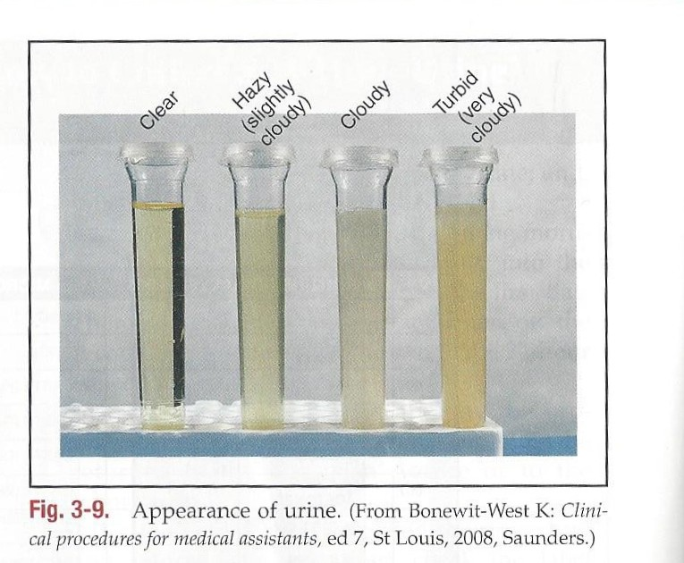
Routine Urinalysis
Appearance / Turbidity/ Clarity
Done the same time the color is evaluated.
Requires a clear container for accuracy.
Terms used to describe appearance:
Clear
Hazy (slightly cloudy)
Cloudy
Turbid (very cloudy)
Substances that may cause a freshly voided urine to appear cloudy are bacteria, yeast, blood cells, casts, mucous threads, and sperm.
These substances could be clinically important and are evaluated further in the chemical and microscopic parts of the UA.

Slide 16
Routine Urinalysis
Specific Gravity
Weight of a substance compared with the weight of an equal volume of distilled water.
The Specific Gravity of distilled water is 1.000
The normal specific gravity of urine ranges from 1.005 – 1.030 depending on patient fluid intake. Most fall between 1.010 – 1.025
Urine specific gravity indicates whether the kidneys are able to concentrate the urine and is one of the first indications of kidney disease.
Presence of glucose, protein, or an x-ray contrast medium used in diagnostic studies also may increase the specific gravity of urine.

Slide 17
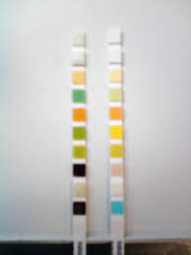
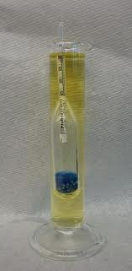
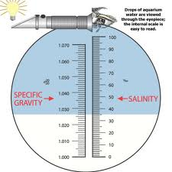
Routine Urinalysis
Measure of Specific Gravity; laboratories may use:
Urinometer
Refractometer
Chemical reagent strip
Chemistry Strips
Urinometer
Refractometer

Slide 18
Routine Urinalysis
Urinometer
Sealed glass float with calibrated paper scale in it’s stem.
Slight spinning motion, Urinometer is placed in a cylinder containing a urine sample and value is read.
Must have 20 - 25mL; if not enough urine for test report out results as QNS
Considered the “Gold Standard” of specific gravity testing.
Refractometer measures the refraction of light through solids in a liquid. The result is called the “Refractive Index”.
Faster and easier to use than Urinometer and requires only one drop of urine.
Refractometer must be calibrated daily with distilled water, which should read 1.000.

Slide 19
Routine Urinalysis
Reagent strip (dipstick) test is the method most commonly used in POL.
It is a waived test.
The pad on the strip contains a chemical that is sensitive to positively charged ions, such as sodium (Na) and potassium (K).
Detects specific gravity in the range of 1.005 – 1.030.

Slide 20
Routine Urinalysis
Chemical Urinalysis
Second part of UA is chemical testing
Helps in the diagnosis of pathological conditions
Reagent Strips
Thin plastic strip containing pads impregnated with chemical reagents that test for specific substances.
When each reagent pad reacts with its specific analyte a color change occurs.
The more of a particular analyte that is present in urine the darker the color will be on the reagent pad.

Slide 21
Routine Urinalysis
Reagent strips
Semiquantitative testing: Testing determines the approximate quantity of an analyte.
Qualitative testing: Indicates whether an analyte is present.
Quantitative testing: Measures the exact amount of a substance and usually requires more complex equipment and procedures not usually available in a POL.
They are time dependent; each test must be read at a specific time.
Tests on strip are referred to as “Screening tests” if results are abnormal then additional testing may be performed.

Slide 22
Routine Urinalysis
Chemical Strips Quality Assurance
Guidelines to follow:
Reagent strip bottle must be kept tightly closed when not in use because moisture from air light and aerosols can affect the accuracy of the testing.
Pads on strip should not be touched or placed on any surface.
Keep the reagent strips in a cool dry place but do not refrigerate them.
Do not use an expired bottle.
Any bottle that has been open longer than 2 months should not be used because of repeated exposure to air, moisture etc.

Slide 23
Routine Urinalysis
Guidelines to follow:
Do not combine strips from different bottles.
Follow all manufacturers directions.
Mix urine specimen well and bring to room temperature.
Make sure all pads are covered with the specimen.
Do not leave the strips in the urine too long because the chemicals in the pads can “leach” (wash out) into the urine
When taking the strip out of the urine remove excess urine by pulling the back side of the strip against the container and then briefly blot the side of the strip against absorbent paper.

Slide 24
Routine Urinalysis
Guidelines to follow:
Hold the strip horizontally to keep the colors on one pad from running into another while you are comparing the colors to the reference testing chart. Do not touch the bottle with the strip while comparing .
Record observed results for each analyte on lab log and requisition.
Use Quality Control Strips to ensure accuracy of results.
Automation: Clinitek Analyzer
Runs the chemical analysis according to the principle of “Reflectance Photometry”
Micropressor controls the movement of the strip into the reflectometer where a light of specific wavelength is beamed into the strip.

Slide 25
Routine Urinalysis
Clinitek
Light that is reflected is measured and is converted into a digital reading and is printed.
Timing and color interpretation are consistent and do not vary by machine as with individual readers.
Disadvantage: With urines that contain a large amount of pigment, the machine cannot recognize this and this can result in false positives.

Slide 26
Routine Urinalysis
Specific Gravity
Normal range 1.005 – 1.030
Indicates kidney ability to concentrate urine
Pathological conditions that increases urine concentration are:
Adrenal insufficiency
Congestive heart failure
Hepatic disease
Glycosuria (sugars in the urine)
Dehydration caused by fever, vomiting and diarrhea.

Slide 27
Routine Urinalysis
Specific Gravity
Pathological conditions that decreases urine concentration are:
Chronic renal insufficiency
Diabetes insipidus
Malignant hypertension
The first morning urine is more concentrated and therefore a higher specific gravity.
Urine becomes more dilute as fluids are consumed throughout the day.

Slide 28
Routine Urinalysis
pH
Measures the level of acidity or alkalinity.
Lungs and kidneys function to maintain the body’s acid alkaline balance.
A pH of 7.0 is neutral. 0-6 is acid and 8-14 is alkaline. Blood pH should range between 7.35 -7.45. Below 7.35 – the body is in acidosis; above 7.45 – the body is in alkalosis.
Normal urine pH 5-8 with the average being 6.0 slightly acid. Urine pH must be measured on a freshly voided specimen because bacteria converts urea to ammonia in urine that has been sitting at room temperature. This conversion causes the urine to become alkaline and indicate a UTI

Slide 29
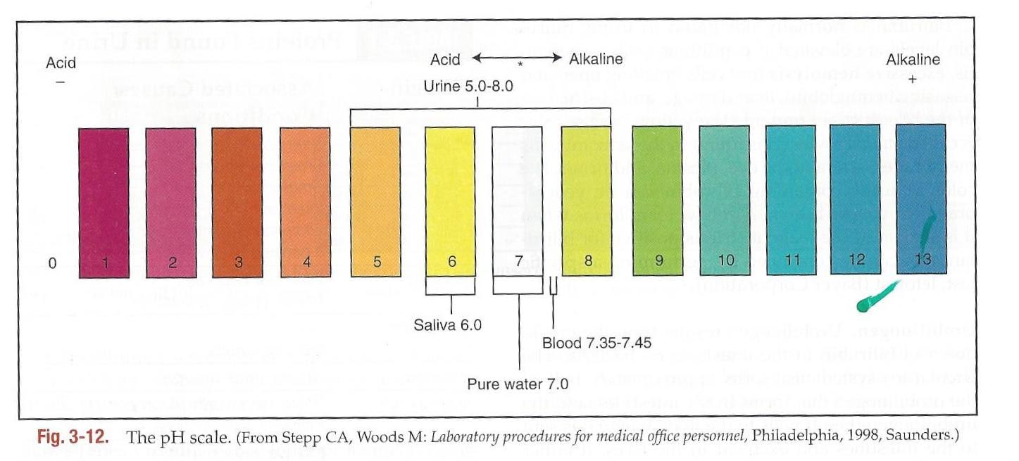
Routine Urinalysis
pH

Slide 30
Routine Urinalysis
Glucose
Not normally found in urine.
Glucose is filtered into the glomerular filtrate and in renal tubule this substance is reabsorbed into the blood. However if the level in the blood has surpassed the renal threshold then it cannot be reabsorbed.
Renal threshold 160 – 180 mg/dL
Glucose in urine = glycosuria
Other sugars in urine: lactose, fructose, galactose and pentose.
Test strip uses enzymatic reaction using the enzyme glucose oxidase.
Glucose in urine as a result of diabetes mellitus; also after vigorous exercise or acute emotional stress.

Slide 31
Routine Urinalysis
Glucose:
False positive glucose test
Large quantities of aspirin
Ascorbic acid (vitamin C)
Medications containing Levadopa
Clinitest is a confirmatory test to determine if other sugars or reducing substances (substances that easily lose electrons) in addition to Glucose are present.
Galactosemia rare metabolic condition in which the body is not able to convert galactose to glucose resulting in excretion of galactose in the urine.

Slide 32
Routine Urinalysis
Galactosemia
In infants results in failure to thrive
Anorexia
Vomiting and diarrhea
Enlargement of liver and spleen
Cirrhosis
Cataracts and mental retardation
Extreme cases can result in permanent brain damage and death.
A positive clinitest and a negative test strip for glucose can indicate galactose in the urine.
Lactose may be found in the urine of pregnant women and in rare cases fructose and pentose can be found in urine because of high consumption of honey or fruit.

Slide 33
Routine Urinalysis
Ketones:
Product of fat metabolism that are then oxidized by the muscles.
Excessive fat metabolism leads to large amounts of ketones that the muscles cannot oxidized. Large amounts of ketones in blood subsequently is found in the urine: This is known as ketonuria.
Ketones and glucose in urine = uncontrolled diabetes mellitus.
Ketones are acid compounds therefore ketonuria is correlated with a low pH.
If Glucose, Ketones and acidity are all present in urine this may indicate a condition known as ketoacidosis. This can lead to diabetic coma.

Slide 34
Routine Urinalysis
Ketones:
Other conditions causing ketonuria
Fever
Starvation
Anorexia
Prolonged vomiting
Diets high in fat and low in carbohydrates.
Ketones evaporate at RT; therefore urine must be tested immediately or tightly capped and refrigerated.
Confirmatory test for positive test strip is the Acetest.

Slide 35
Routine Urinalysis
Bilirubin
RBC (lives 120 days) …..cell dies and releases hemoglobin.
Heme, a product of hemoglobin decomposition, subsequently breaks down to form bilirubin. Bilirubin at this point attaches to a protein (albumin) in the blood and is not water soluble and cannot because of its size does pass through the glomerulus. Once the protein bound bilirubin passes through the liver it becomes water soluble. It then enters the gall bladder and is excreted into the intestines. In the intestine it is known as urobilinogen.
Bilirubin therefore is normally not found in the urine.

Slide 36
Routine Urinalysis
Bilirubin
Elevated levels in urine as a result of:
Hepatitis
Excessive hemolysis of RBCs
Liver damage
Obstruction of the bile ducts.
Color of urine with excessive Bilirubin can be yellow orange to yellow brown
Yellow foam when shaken
A positive test strip for bilirubin can be confirmed with a specific test known for bilirubin Ictotest.

Slide 37
Routine Urinalysis
Urobilinogen:
Small amounts may be present in the urine. It is mainly excreted by the intestines in the feces.
Urobilinogen may be increased:
Excessive hemolysis of RBCs
Cirrhosis
Infectious mononucleosis
Congestive heart failure.

Slide 38
Routine Urinalysis
Blood
Three types of blood components give positive reagent strip reaction for blood.
Intact RBCs = Hematuria; usually occurs with UTI associated with bleeding, such as cystitis and urethritis. Kidney stones, tumors and lesions may also cause bleeding.
Hemoglobin = hemoglobinuria; caused by transfusion reactions, malaria, drug reactions, snake bites and severe burns. Because it is the result of hemolyzed RBCs that are no longer visible it is termed “Occult Blood”.
Myoglobin = an oxygen storing pigment of muscle tissue, can be found in urine after massive muscle injury, physical trauma or electrical injury.

Slide 39
Routine Urinalysis
Protein
One of the first signs of renal disease is proteinuria….large amounts of protein in the urine.
Normally proteins are too large to pass through the glomerulus.
Small amounts of protein may be present in urine and not be pathogenic for example:
Fever
Exposure to heat or cold
Excessive exercise
Emotional stress

Slide 40
Routine Urinalysis
Protein found in urine
Albumin - Strenuous physical exercise; emotional stress; pregnancy; Infection, Glomerulonephritis; neonates first week.
Globulins – Glomerulonephritis; renal tubular dysfunction
Hemoglobin – Hematuria; Hemoglobinuria
Nucleoprotein – White blood cells in urine; Epithelial cells in urine.
Bence Jones – multiple myeloma; leukemia
In addition pregnant women are routinely checked for protein in the urine because it may be a sign of preeclampsia.
Correlating protein with Specific Gravity is important because urine with a low Specific Gravity showing a trace or small amount of protein may be significant.

Slide 41
Routine Urinalysis
Nitrites
Nitrates are converted to nitrites by some bacteria
First morning specimen needed for this test because urine is held in bladder for 4-5 hours giving bacteria time to convert nitrates to nitrites.
Urine should not be left standing because bacterial contaminants can convert the nitrates to nitrites resulting in a false positive reaction.
A positive nitrite test is usually correlated with a positive leukocyte test.

Slide 42
Routine Urinalysis
Leukocytes:
Determines the presence of leukocytes (WBC).
Strip tests for esterase which is produced by lysed granulocytic WBC.
Presence of WBCs usually indicates a URI and should be correlated with a nitrite test.

Slide 43
The End

