Slide 1
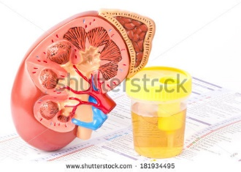
Anatomy of the Urinary Tract

Slide 2
Urinary Tract
Anatomy of Urinary Tract
Need basic knowledge of kidney structure
Urine formation knowledge
Both necessary to understand results of a UA
Urinary Tract
Two kidneys
Two ureters
One bladder
One urethra

Slide 3
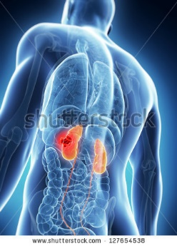
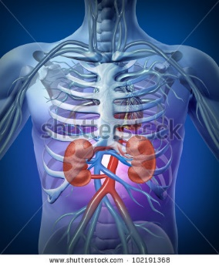
Urinary Tract
Kidneys – 2
Reddish Brown bean shaped organs
Four to five inches long and located in the retroperitoneal space slightly above the waistline in the posterior wall of abdominal cavity.
(Behind the peritoneal cavity)
Kidney made up of three (3) main sections:
Cortex: Outer part
Medulla: Middle section
Renal pelvis: hollow inner section.
Basic functional unit = Nephron (microscopic)
More than 1,000,000 million nephrons

Slide 4
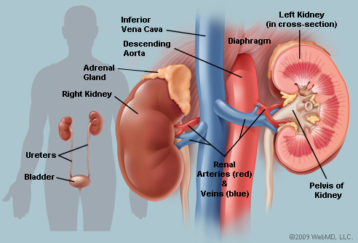
Urinary Tract
Urinary System Part 1- The Kidneys - YouTube

Slide 5
Urinary Tract
Nephron:
Located within the cortex and medulla.
Filter waste from the blood and simultaneously maintain the essential water and electrolyte balance of the body.
Structural components of nephron are renal corpuscle and renal tubules.
Renal Corpuscle consists of two structures:
Glomerulus:
Glomerular (Bowman’s capsule)

Slide 6
Urinary Tract
Glomerulus:
Made up of tangled blood capillaries in which the hydrostatic pressure in the capillaries pushes substances through the capillary pores.
Filtered substance is the glomerular filtrate and is collected in the glomerular capsule. (Bowman’s capsule) – a cup shaped structure surrounding the glomerulus.

Slide 7
Urinary Tract
Renal Tubules:
Composed of proximal convoluted tubules
The nephron loop (loop of Henle)
Distal convoluted tubles
Glomerular filtrate fluids flows through these tubules and undergoes changes in composition.
Additionally:
Within the medulla of the kidney are collecting tubules and ducts that empty into the renal pelvis.

Slide 8
Urinary Tract
Ureters
Two in number
Slender muscular tubes 10 – 12 inches long
Function: Carry urine formed in the kidneys to the urinary bladder.
Bladder:
Hollow muscular organ that hold the urine until it is expelled by a process call micturition ( also referred to as voiding and urination).
Uretha:
A tubular structure
Function carries urine to the outside of the body.
Size female 1.5 inches; male 8 inches
Opening at end of uretha where urine is excreted is called Uretha meatus.

Slide 9
Urinary Tract

Slide 10
Urinary Tract

Slide 11
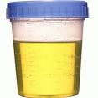
Formation and Flow of Urine
The Kidney selectively excretes or retains substances according the body’s needs and renal thresholds.
Approximately 1,200 mL of blood flows through the kidneys each minute.
Nephron: Basic unit of kidney where urine is formed Urine formed by three mechanisms
Filtration
Reabsorption
Secretion

Slide 12
Formation and Flow of Urine
Filtration: the process by which fluids and dissolved substances in the blood are forced through the pores of the glomerulus into the glomerular capsule by hydrostatic pressure.
Filtration:
Substances: water, salts, sugar and nitrogen waste products (urea, creatinine and uric acid) pass through the pores.
Substances: RBCs, and proteins are too large therefore remain in the blood.

Slide 13
Formation and Flow of Urine
Reabsorption: Process by which some of the substances that flow through the renal tubules that are needed by the body cross back into the blood by the peritubular capillaries surrounding the tubules.
Examples: glucose, water, electrolytes. (Electrolytes: elements or compounds that form positively or negatively charged ions that when dissolved, can conduct electricity.)
When blood levels of a substance such as glucose reach a point at which no more can be reabsorbed, the substance is excreted in the urine….Renal Thresholds: levels at which substances cannot be reabsorbed by the renal tubules and therefore excreted in the urine.
FYI: Renal threshold for glucose = 160 -180 mg/dL

Slide 14
Formation and Flow of Urine
Secretion: Final process in the formation of urine.
Substances are carried from the peritubular capillaries into the renal tubules.
Examples: Metabolized drugs, potassium, and hydrogen ions are examples of substances that are secreted into the urine.

Slide 15
Formation and Flow of Urine
Flow of Blood and Urine through the kidneys:
Blood carried into the kidney by the renal artery
Renal artery branches into the afferent arterioles.
Afferent arterioles carry blood into the capillaries of the glomerulus.
Efferent arterioles carry blood out of the glomerulus.
Glomerular filtrate is collected in the glomerular capsule (Bowman’s) and flows through the proximal convoluted tubules to the nephron loop.
Then to the distal convoluted loop, the collecting tubule, the collection duct, and finally to the calyces of the renal pelvis.
The filtrate then flows into the hollow renal pelvis and at this point is called urine.

Slide 16
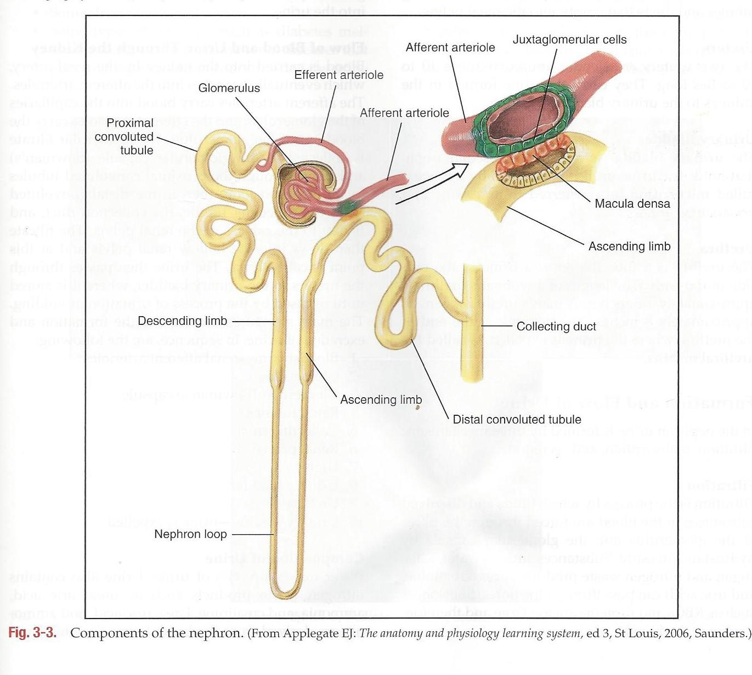
Flow of Urine
The urine then passes through the ureters to the urinary bladder.
Urine is stored in the bladder until released by a process known as urination, voiding or micturition.
10 Step process:
Blood stream – renal afferent arterioles.
Glomerulus
Glomerular capsule (Bowman’s)
Renal tubules
Collecting ducts

Slide 17
Flow of Urine
10 Step process cont
Renal pelvis
Ureter
Urinary bladder
Urethra
Urinary meatus – urine expelled.

Slide 18
Composition of Urine
Water is 95% of urine
Contains Nitrogen waste products such as urea, uric acid, ammonia and creatinine. Urea, uric acid and ammonia are derived from the breakdown of protein. Creatinine is a waste product of muscle metabolism.
Other waste products include Chloride, sodium, potassium, calcium, magnesium, phosphate and sulfate.
As mentioned 1,200 mL of blood passes into the renal arteries per minute with a daily output of 1200 – 1500 mL of urine per day.
Volume varies dependent on the amount of fluid intake and the amount of fluid lost from perspiration, feces, and water vapor from the lungs.

Slide 19
Terms related to urination
Oliguria: decreased urine volume that can occur in the following situations:
Decreased fluid intake
Vomiting
Profuse sweating
Diarrhea
Kidney disease.

Slide 20
Terms related to urination
Diuresis: increase in the volume of urine output, which can be caused by the following
Intake of excessive amounts of fluids, especially those that contain caffeine
Some drugs such as diuretics
Some types of diseases, such as diabetes mellitus, diabetes insipidus, and renal diseases that prevent the kidney from concentrating the urine.
Anuria – no flow of urine
Dysuria – painful urination
Nocturia – excessive urination at night
Polyuria – frequently passing abnormally large amounts of urine.

Slide 21
END

