Slide 1
Urinanalysis
Vocabulary and Introduction

Slide 2
Amorphous
Pronounced: a-mohr’-fuhs
Definition Lacking a defined shape

Slide 3
Bilirubinuria
Pronounced: bi-li-roo’-bin-yuhr-e-uh
Definition: The presence of bilirubin in the urine

Slide 4
Colony-forming units (CFUs)
Definition: A term used when reporting bacteriuria: one CFU represents on bacterium present in the urine sample

Slide 5
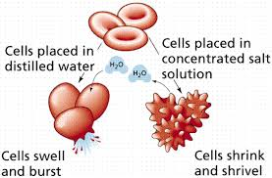
Crenate
Definition: Forming notches or leaf like, scalloped edges on an object.

Slide 6
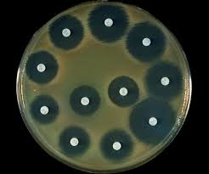
Culture and sensitivity (C&S)
Definition: A procedure performed in the microbiology laboratory in which a specimen is cultured on artificial media to detect bacterial or fungal growth, followed by appropriate screening for antibiotic sensitivity.

Slide 7
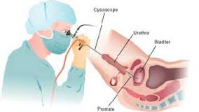
Cystoscopy
Definition: Visual examination of urinary bladder using a fiberoptic instrument

Slide 8
Enzymatic Reaction
Definition: A chemical reaction controlled by an enzyme

Slide 9
Filtrate
Definition: The fluid that remains after a liquid is passed through a membranous filter.

Slide 10
Gold Standard
Definition: The paragon of excellence; the diagnostic test against which all others are compared.
Define paragon: a model or pattern of excellence or of a particular excellence; ideal or exemplar

Slide 11
Metabolite
Definition: The product of the metabolism of a substance, such as a drug.

Slide 12
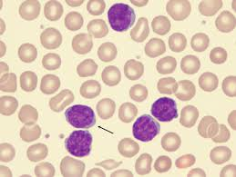
Mononuclear white blood cells
Definition: Leukocytes with an unsegmented nucleus; monocytes and lymphocytes in particular.

Slide 13
Myoglobinuria
Definition: The abnormal presence of a hemoglobinlike chemical of muscle tissue in the urine; it is the result of muscle deterioration.

Slide 14
Phenylalanine
Pronounced: fr-nehl-ah’-luh-nen
Definition: An essential amino acid found in milk, eggs, and other foods.

Slide 15
Refractile
Pronunciation: re-frak’-tuhl
Definition: Causing light to refract or bend, thus creating a sharp boundary or image.

Slide 16
Renal thresholds
Definition: Levels above which substances cannot be reabsorbed by the renal tubules and therefore are excreted in the urine.

Slide 17
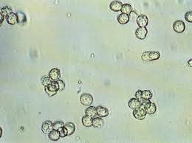
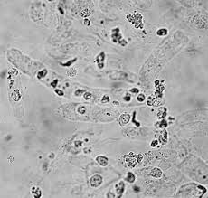
Sediment
Definition: Insoluble material that settles to the bottom of a urine specimen. Therefore the supernatant is the liquid portion of urine on top of the spun sediment.

Slide 18
Supravital
Definition: Of, related to, or capable of staining living cells after their removal from a living or recently dead organism.

Slide 19
Lipiduria
Definition: Lipids in the urine

Slide 20
Micturition
Definition: Expelling of urine , also referred to as voiding and urination.

Slide 21
Nephron
Definition: Functional unit of the kidney

Slide 22
Nocturia
Definition: Excessive urination at night.

Slide 23
Oliguria
Definition: Decrease in volume of urine output

Slide 24
pH
Definition: Scale that measures the level of acidity or alkalinity of a solution.

Slide 25
Proteinuria
Definition: Protein in the urine

Slide 26
Pyuria
Definition: White Blood Cells in the urine

Slide 27
Renal Capsule
Definition: Part of the Nephron that contains the glomerulus and glomerular capsule.

Slide 28
Renal Threshold Level
Definition: Blood reabsorption limit of a substance and the point at which the substance is then excreted in the urine.

Slide 29
Specific Gravity
Definition: In urinalysis the weight of urine compared with weight of an equal volume of water. Measures the amount of dissolved substances in the urine.
Normal range: 1.005 – 1.030

Slide 30
Urinalysis (UA)
Most common laboratory tests used in diagnosis and treatment of disease.
Non invasive
Quickly performed
Results reveal various conditions:
Diseases of the bladder or kidney
Systemic metabolic or endocrine disorders
Diabetes
Diseases of the liver
Hepatitis
Cirrhosis
Obstruction of the bile ducts

Slide 31
Urinalysis
Cirrhosis (se’ roses)
A chronic disease of the liver marked by degeneration of cells, inflammation and fibrous thickening of tissue. It is typically a result of alcoholism or hepatitis.

Slide 32
Urinalysis (UA)
History
Recognized for centuries that abnormalities in the urine are possible indicators of a disruption of homeostasis.
Homeostasis: (homeo’-stasis)
The tendency toward a relatively stable equilibrium between independent elements especially as maintained by physiological processes.
Earliest known tests of urine involved pouring it on the ground to see whether it attracted insects.
If attracted = “honey urine” was excreted by people with skin eruptions. Today’s version of the test is the test for Glucose.

Slide 33
Urinalysis
Historically, examination of the urine became a game for quacks and charlatans
Pictures from the Middle Ages show physicians examining flasks of urine
Claimed diagnosis of disease
Reading of future (Charlatans became know as “pisse prophets”)
Charlatan = a person claiming to have a special knowledge or skill, a fraud
Twentieth Century
Became a practical laboratory procedure
Most commonly analyzed fluid in clinical laboratory.

Slide 34
Urinalysis
Analyzed for several reasons
1. Detect extrinsic conditions: Kidneys function normally but abnormal end products of metabolism are excreted as a result of an imbalance in homeostasis.
Example = Glucose in urine as a result of hyperglycemia
2. Detect intrinsic pathologic conditions that involve kidneys or urinary tract.
Example = Kidney stones ; Urinary tract infection
3. Determine the effectiveness of medication and or the possibility of urinary system side effects from prescribed drugs.

Slide 35
Urinalysis
Function of the Urinary System
1. Removes unwanted waste
2. Stabilizes blood volume, acidity and electrolytes
3. It regulated extracellular fluids of the body and the adsorption of calcium ions by activating vitamin D.
4. It secretes the hormone erythropoietin, which controls the rate of RBC formation and the hormone renin which regulates blood pressure.

Slide 36
That’s All Folks

