Slide 1
Ethics in Research
Student Names
Course ID
Date
Dr. Aizon

Slide 2
Agenda
Define Ethics
Case Examples of Ethics
Historical Context
Discuss the three ethical principles outlined in the Belmont Report: beneficence, autonomy, and justice
Describe the function of an Institutional Review Board
Codes of Ethics

Slide 3
Definition of Ethics
Ethics is the study of what is proper and improper behavior; of moral duty and obligation (Cozby, Bates, 2018)
Ethics involves responsibilities toward (Monnett, Sullivan, DeJong, 2014):
Participants
Sponsors
Potential beneficiaries
Ethics is exercised in every aspects of research and therapy (Aizon, 2018)

Slide 4
Historical Context of Current Ethical Standards
Nuremberg Code: 10 rules of medical research conduct developed in response to Nazi research atrocities
Declaration of Helsinki: expanded on the Nuremberg Code in 1964 and required journal editors to ensure published research was compliant
Continued news about ethically questionable studies spurred production of the Belmont Report in 1972
Belmont Report: Defines the principles and applications that apply to medical and behavioral research investigations
(Cozby, Bates, 2018)

Slide 5
Basic Values: The Belmont Report
Respect for persons: We recognize the personal dignity and autonomy of individuals, and we should provide special protection of those persons with diminished autonomy
Beneficence: We have an obligation to protect persons from harm by maximizing anticipated benefits and minimizing possible risks of harm
Justice: The benefits and burdens of research should be distributed fairly

Slide 6
APA Ethics Code
Five general ethical principles echo the Belmont Report.
Beneficence — Need for research to maximize benefits and minimize any possible harmful effects of participation
Fidelity and responsibility — Psychologists establish relationships of trust with those with whom they work
Integrity — Psychologists:
Seek to promote accuracy, honesty, and truthfulness in the science, teaching, and practice of psychology
Do not steal and cheat or engage in fraud, subterfuge, or intentional misrepresentation of fact
Justice — Psychologists recognize that fairness and justice entitle all persons:
Access to and benefit from the contributions of psychology
Equal quality in the processes, procedures and services being conducted by psychologist
Respect for persons: Psychologists:
Respect the dignity and worth of all people and the rights of individuals
Are aware that special safeguards may be necessary to protect the rights and welfare of some persons or communities
Are aware of and respect cultural, individual, and role differences
Try to eliminate the effect of biases on their work
(Cozby, Bates, 2018)

Slide 7
Assessment of Risks and Benefits
Risk-benefit analysis: Examination of the potential risks and benefits that are likely to result from a research program
Risks in psychological research
Physical harm
Psychological stress and distress
Loss of privacy or confidentiality
Potential benefits of psychological research
Educational, new skill acquisition, or treatment for a psychological or medical condition
Material benefits
Personal satisfaction
Applications of the research findings
(Cozby, Bates, 2018)

Slide 8
Institution Review Board Criteria
Risks to subjects are minimized
Risks to subjects are reasonable in relation to anticipated benefits
Selection of subjects is equitable
Informed consent is sought
Informed consent is documented
Monitoring of data collection ensures subject safety
Provisions to protect privacy and to maintain confidentiality

Slide 9
Institutional Review Boards (IRBs)
Any institution that receives federal funds must have an IRB that is responsible for reviewing research at that institution.
Must have minimum five members
One must be an external member
Research conducted by students, faculty and staff must be reviewed by the IRB.
Exempt research: Risk free
Review is not required
Minimal risk: Risk of harm is no greater than risk encountered in daily life or routine tests
Routine review conducted by the IRB
Greater than minimal risk research
Thorough review conducted by the IRB
(Cozby, Bates, 2018)

Slide 10
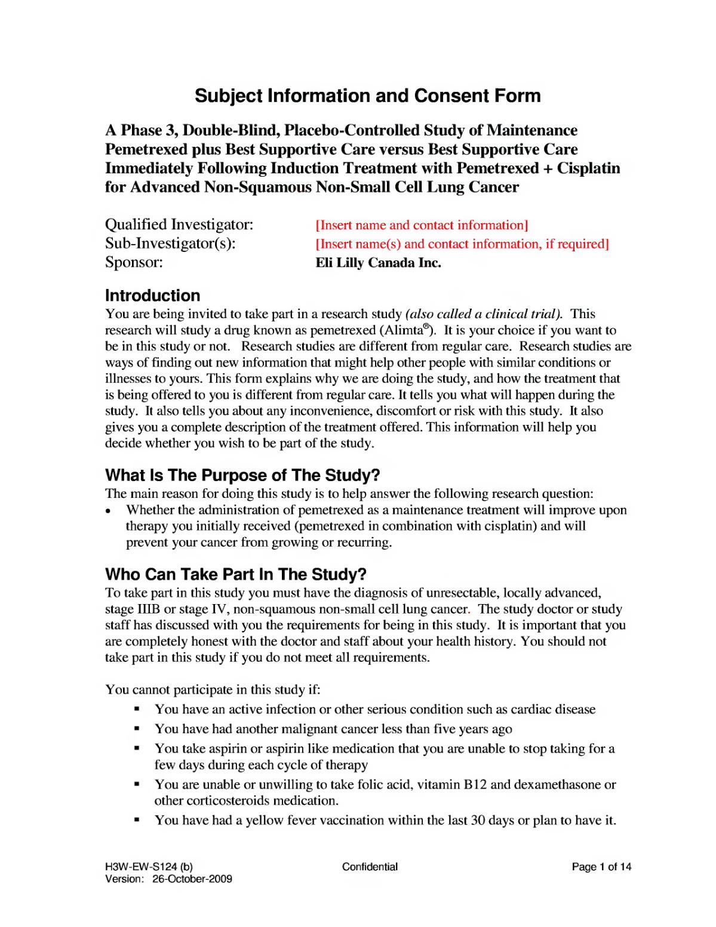
Ethical Issues
Informed consent
Deception
The right to privacy (anonymity and confidentiality)
Physical or mental distress
Problems in sponsored research
Scientific misconduct or fraud
Scientific advocacy
Image from Eli Lilly and Company
Notes:
Image: Subject Information and Consent Form retrieved from https://en.wikipedia.org/wiki/File:PARAMOUNT_Eli_Lilly_Informed_Consent_Document.djvu. This file is licensed under the Creative Commons Attribution 3.0 Unported

Slide 11
Codes of Ethics
American Sociological Association
Committee on Professional Ethics
American Sociological Association Code of Ethics
National Association of Social Workers
American Psychological Association
American Association for Public Opinion Research

Slide 12
References
Aizon, A. (2018). Ethics in Research Lecture. Information curated and edited for Madera Community College PSY 45. Retrieved from https://scccd.instructure.com/courses/25210/pages/1-getting-started-on-research.
Cozby, P., Bates, S. (2018). Methods in Behavioral Research 13thedition. New York, NY: McGraw Hill.
Monnett, D.R., Sullivan, T.J., DeJong, C.R. (2014). Applied Social Research: A Tool for the Human Services 9th edition. Belmont, CA: Brooks /Cole.

