Slide 1
Committee Chairs Training
Reedley College

Slide 2
Committee Structure
The __________ __________ is the overarching shared governance body for the college.
__________ committees are categorized as either committees of the __________ or of the Academic __________.
Two other committee types exist. A __________ is made up of a small number of members of a regular committee. An __________ committee is a special, short-term committee focused on a specific task.
All committees eventually make __________ to the College Council and/or __________.

Slide 3
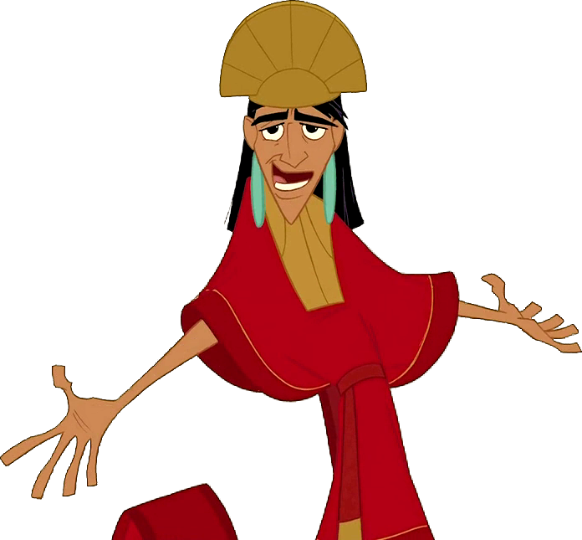
Why does your committee exist?
REEDLEY COLLEGE PARTICIPATORY GOVERNANCE HANDBOOK
Revised and Adopted by the Reedley College Council: Soon, we hope
The charge of a committee of any type will be to gather __________, deliberate, report, and formulate __________ regarding policies and procedures which will be forwarded to the College __________, the __________ of Reedley College, and/or the Board of Trustees.

Slide 4
What’s your purview?
Committees of the College
Accreditation and Institutional Effectiveness
Budget College Council Distance Education
Dual Enrollment
Facilities
Sabbatical Leave (membership designated by contract)
Salary Advancement (membership designated by contract)
Staff Development
Strategic Planning
Student Success (Basic Skills/Enrollment
Management)
MCCC College Center Council
Committees of the Senate
Academic Standards
Curriculum
Equivalency
Faculty Professional Development (FLEX)
Program Review
Student Learning Outcomes (SLO)

Slide 5
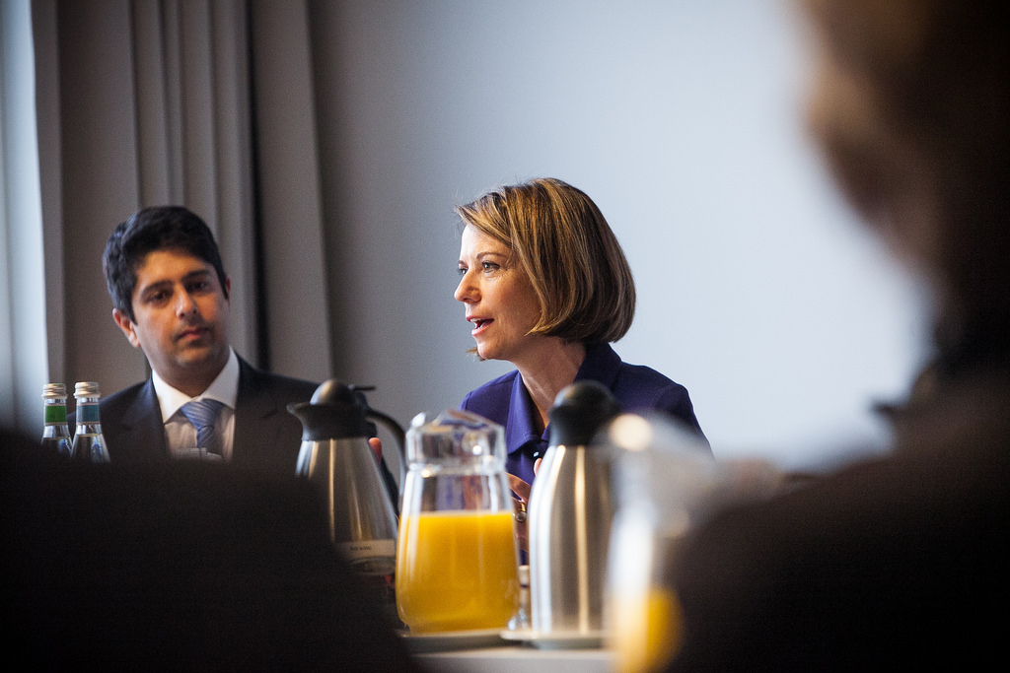
The job of a committee chair is to:
To create and distribute the __________ and related materials ahead of the meeting date.
To convene the meeting at the appointed __________.
To maintain order and recognize __________ entitled to speak.
Enforce meeting __________.
To __________ business in every way compatible with the rights of members.
To __________ and forward the committee __________ to the appropriate authority.
Maintain a full committee by reporting __________ (habitual absenteeism) to the appointing body.

Slide 6
Minutes or Notes?
Committees should be compiling and posting minutes, notes … or probably more appropriately, a combination of both.
__________ are a record of the ACTIONS taken by a committee only. They should include the motion, who made it, if there was a second, and the outcome of the vote.
__________ are an overview or synopsis of the discussion at a meeting. They should be separate and after any minutes, but may be on the same document. Notes should NOT identify who said what in the discussion.
* see the Minutes & Notes Explained cheat-sheet in the Canvas module for examples.

Slide 7
New Year To-Do List
Make sure your committee membership is ____-____-_______.
Have an __________ for your members, you may have new members.
Purpose
Meeting norms
Reporting procedures.
Review your __________ __________ __________ (COA).
Purpose
Maybe create an ad hoc committee to recommend updates or changes
Forward to College Council for acceptance
Make sure date of review and approval is in the footer of the document.

Slide 8
Standardized Forms
By Fall of 2019, the College Council hopes to have a standardized, fillable form to make the job of creating and updating COAs more convenient.
College Council may very soon be approving a standardized Report form and a Minutes/Notes form to allow committee members to easily and using the same familiar format, report the actions and discussion of committee meetings to their constituent groups.

